Slide 1
Predicting Uber Costs
Thomas Gragossian

Slide 2
The Dataset
We used the Uber Fares Dataset, containing the columns:
# (index purposes)
key: Datetime
fare_amount: cost of the fare
pickup_date: Datetime (same as key)
pickup(dropoff)_longitude: pickup/dropoff longitude, two columns
pickup(dropoff)_latitude: pickup/dropoff latitude, two columns
passenger_count: number of passengers
Notes:
Zainab

Slide 3
Goals
We aim to predict three main things:
If a trip is expected to be in the top 25% of fare per mile costs
What is the expected fare per mile cost?
What is the actual fare for this trip.
We split it into these three categories because the first binary category is something very useful to know as a user, where fare per mile is the most sensible to "normalize" the cost with respect to distance. This leads us into our second, fare per mile cost, which we use in predicting the first category. Lastly, the fare itself helps the user understand the cost more relatively for them.
Notes:
Zainab

Slide 4
Stakeholders & Context
Riders (primary) - want clear, predictable fares for specific routes/times
Drivers (secondary) - want to identify profitable time/areas to work
Uber (tertiary) - wants accurate pricing to balance demand, supply & profit
City/regulators (indirect) - care about equity, congestion, access
Geographic context: models trained on NYC Uber trips, but methods generalize to other cities
Notes:
Zainab
Riders: “Our main users. They care about ‘How much will my ride cost at this time, on this route?’ Better prediction helps them budget and detect unusually high prices.”
Drivers: “They can use patterns in fare and demand over space and time to choose when and where to drive to maximize earnings and avoid low-fare trips.”
Uber/platform: “The platform uses these models to set dynamic prices that keep wait times low, keep drivers online, and still protect revenue.”
City/regulators: “Accurate spatial-temporal fare patterns can inform policies around surge pricing, equity across neighborhoods, and congestion management.”
NYC focus: “Because the data is mostly NYC, the numerical results are NYC-specific, but the modeling pipeline can be applied to any city once we have similar data.”

Slide 5
Feature Engineering
Trip distance in miles (haversine)
Time features: time-of-day bin, weekday rush, Fri/Sat late-night
Year + inflation data for long-term trend
Airport proximity (JFK, LGA, EWR)
Removed locational outliers (NYC only), see next slide for graphic
Notes:
*Jiangyu
Our data mainly covers trips from 2009–2015, so we engineered features to capture where and when a trip happens, and how that might affect price.
First, we computed trip distance in miles using the haversine formula on pickup and dropoff latitude/longitude. That gives us a more accurate distance than just subtracting coordinates.
Next, we binned time of day into categories:
The time binning was done:
Early morning: 4 to 6
Morning rush 6 to 10
Midday 10-16
Evening rush 16-20
Evening 20-23
23-4 late night
On top of that, we created two binary indicators:
Weekday rush hour (weekdays during morning/evening rush), to capture commute-time demand and “surge” behavior.
Friday/Saturday peak night, to capture the party crowd and weekend nightlife demand.
We also kept the year of the trip and joined in a separate CSV with inflation data, so we could model how the average fare-per-mile changes over time and try to forecast to 2025. This ended up being somewhat off for recent years because the underlying trip data is relatively old compared to today’s prices, but it still gives a reasonable long-term trend.
Finally, we used the coordinates of the three major NYC airports—JFK, LaGuardia, and Newark—and added one-hot indicators for whether pickup or dropoff was near one of these airports. Airport trips are priced differently, so this is an important location signal.

Slide 6
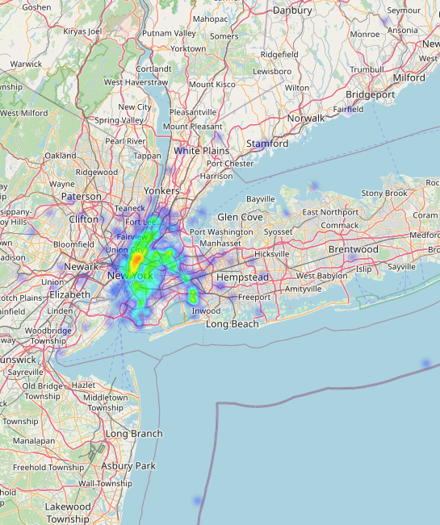
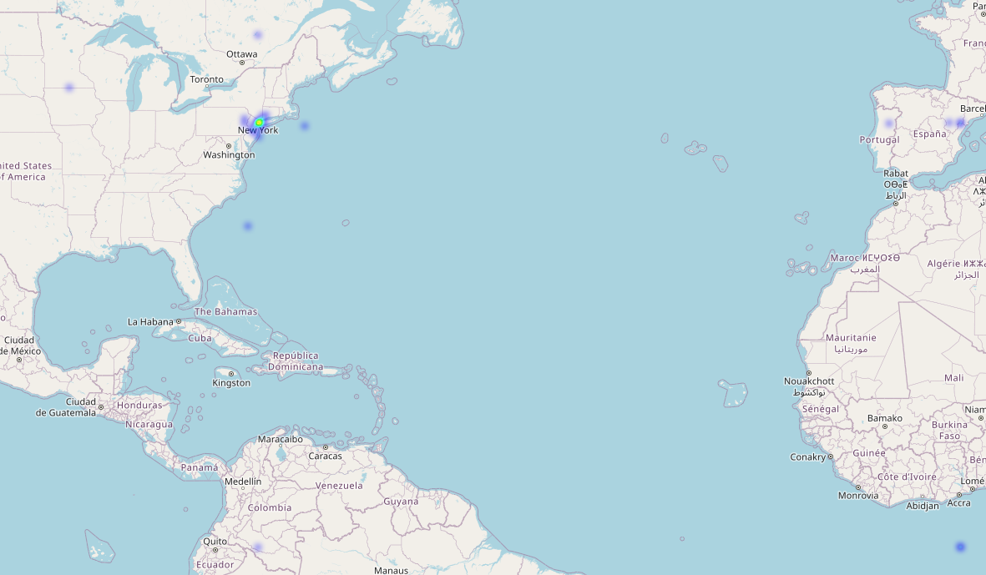
Location Data Graphic
(Global outliers, most likely due to GPS or signal fluctuations or faulty records)
(Some outliers still present on waters after global filtering)
Notes:
*Jiangyu
These two maps show why we needed to filter by location.
On the left, we plot pickup locations for the entire raw dataset. You can see a dense cluster around New York City, but also a bunch of points scattered across the US and even other countries. Those are either other cities or obvious data issues for our NYC-focused project.
On the right, we plot the same thing after filtering: we only keep trips where both pickup and dropoff fall within a reasonable NYC latitude/longitude box. This removes all the global outliers and leaves us with a very clean, dense cloud of NYC trips.
All of the modeling we’ll talk about next uses only the filtered NYC data.
ERROR WITH DISTANCE: miles is based on straight line, not total street lengths

Slide 7
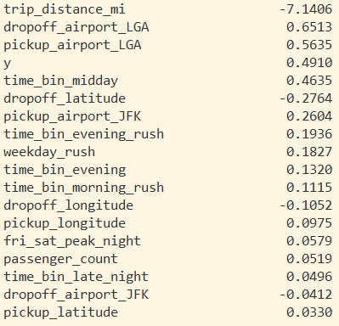
Feature Selection
We used LASSO to see what features in the previous slide to eliminate, these were the results for the coefficients, and nothing was removed.
Notes:
*Jiangyu

Slide 8
Models Used And Methods
Feature Engineering
Filters (~192k valid trips) on 80/20 train-test split
LASSO feature selection with standard scalar and GridSearchCV
Random Forest (RF)
Neural Network (NN)
Ensemble of RF and NN for is expensive
RF only for fare and fare per mile
Notes:
THOMAS
After filtering, we ended up with about 192k valid NYC trips. We applied three main filters:
Trip distance > 0.1 miles
Fare between $0 and $500
Remove rows with missing key fields (distance, fare, datetime, passenger count)
We then did an 80/20 train–test split, stratified on our main classification label.
For the classification target, we defined:
fare_per_mile=fare_amount/trip_distance_mi
and labeled a trip as “expensive” if its fare per mile was in the top 25% of all trips. That gives us a binary label that’s meaningful to a user—“is this trip unusually expensive per mile?”—and we also keep the numeric fare_per_mile and fare_amount for regression.
Before training the main models, we did feature selection with LASSO:
Pipeline: StandardScaler plus logistic regression with an L1 penalty, we tried regularization coefficients 0.01, 0.1, 1, 10
Tuned the regularization parameter C with GridSearchCV
Used 5-fold cross-validation, scoring with ROC-AUC
This identified a set of about 18 features with non-zero coefficients—things like distance, time-of-day bins, year, and airport indicators. We used that reduced feature set in all downstream models.
For the classification task (“expensive” vs not), we trained:
Logistic Regression as a baseline,
a Random Forest classifier with n_estimators in {100, 200} and max_depth in {None, 20}, using 3-fold CV, and
a Neural Network (MLPClassifier) with hidden layers (64, 32) (the latter won) and alpha in {1e-4, 1e-3}, again tuned with 3-fold CV and ROC-AUC.
The best performance on the held-out test set came from an ensemble that takes the average of the RF and NN predicted probabilities. That ensemble slightly improves ROC-AUC and accuracy over either model alone.
For the regression tasks—predicting total fare and fare-per-mile—we tried:
Random Forest Regressor
We evaluated them using MAE, RMSE, and especially normalized MAE, which is MAE divided by the mean of the target. Normalized MAE is helpful here because fares and fare-per-mile have different scales and fairly high variance.
We found that the Random Forest Regressor consistently had the lowest normalized MAE for both total fare and fare-per-mile, and simple ensembles with the other regressors actually made performance slightly worse. So in our final system, we use:
RF+NN ensemble for the classification “is expensive?” prediction, and
Random Forest Regressor for both of the numeric predictions.
We also tried using various forms of gradient boosting, as well as linear regression to predict these numerical targets. Linear regression performed particularly poorly using the nMSE metric, whereas gradient boosting performed decently, but did not meaningfully impact the ensemble’s performance when added in.

Slide 9
Results
Final dataset: 195,806 trips (filtered from 200k)
Expensive threshold: $8.06 per mile
Class balance: 144,169 non-expensive / 48,057 expensive
Classification
Random Forest AUC: 0.9337
Neural Network AUC: 0.9368
Ensemble AUC: 0.9378 ← Best classifier (combines RF + NN)
Accuracy: 0.89 / Weighted F1 score: 0.88
Regression (Random Forest)
Fare MAE: $1.72, RMSE: $3.56, nMAE: 0.153
Fare-per-mile MAE: $1.44, RMSE: $6.76, nMAE: 0.200
Notes:
Vivienne
After filtering invalid or out-of-range trips, our final dataset contains about 195,800 rides.
We define a trip as expensive if its fare per mile is higher than $8.06.
This gives us a class balance of around 144,000 non-expensive trips and about 48,000 expensive trips.
For classification, Random Forest achieved an AUC of 0.9337, and the Neural Network achieved 0.9368.
When we combine both models into an ensemble, we get the best performance with an AUC of 0.9378.
Overall, the model reaches about 0.89 accuracy and a weighted F1 of 0.88, which shows strong predictive performance even with class imbalance

Slide 10
Prediction Demo
211 Main St to 3 Brewster Rd (Newark Airport)
211 Main St: 40.7839 latitude and -74.2340 longitude
3 Brewster Rd: 40.7304 latitude and -74.1789 longitude
predict(40.7839, -74.2340, 40.7304, -74.1789, 1, "2025-11-30 12:10:00", arts))
Notes:
Vivienne

Slide 11
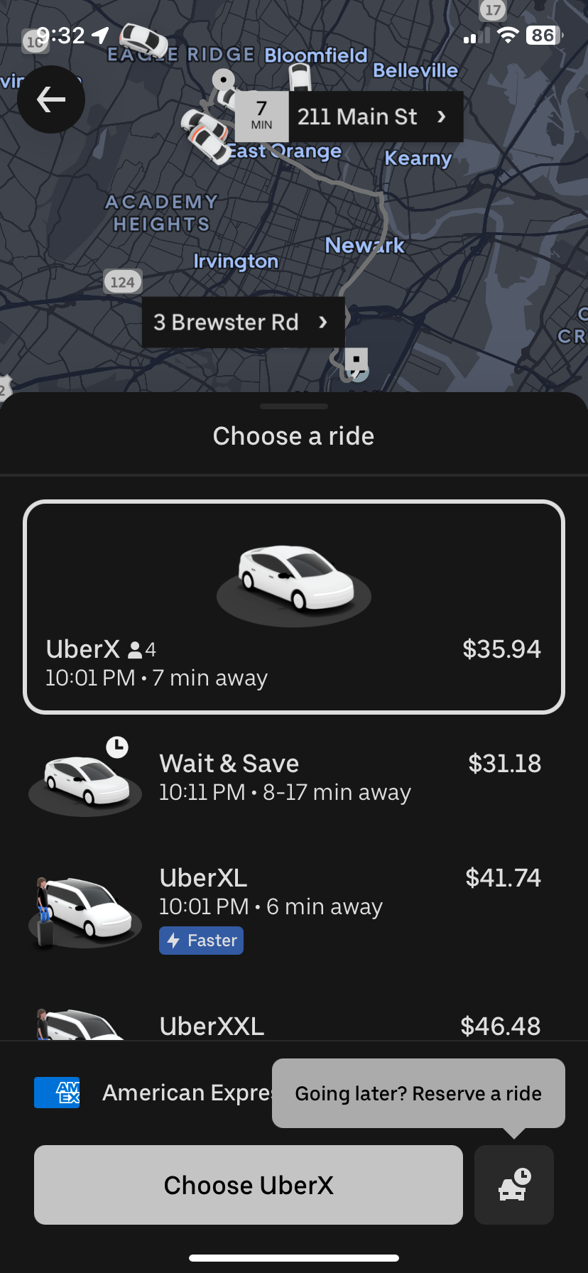
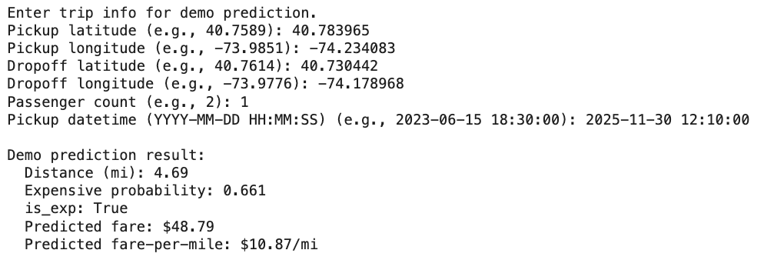
Notes:
Rahul
lack of recent data - early 2010s / early uber… / Linear model is not a good fit - not a linear trend

Slide 12
Discrepancies and Missing Information
No Surge Pricing:
Uber dataset does not include surge pricing
Our model could not capture the price peaks during high demand or bad weather conditions
No Promotions/Discounts:
Ignored uber credits, coupons, and any price changes
Low fares could not be explained properly
Early Uber:
Dataset is Uber’s early phase which is different from today's user experience and pricing in 2025
Ignores many of today’s features such as Uber One or UberX
Dataset itself also lack of precise routes/distances with a few faulty outliers
Notes:
Rahul

Slide 13
Conclusion
Successfully predicted total fare, fare per mile, and expensive rides
(RF + NN) best classifier and was able to achieve AUC of 0.9378
Random Forest regression predicted fares with MAE of $1.72
Feature Engineering such as distance, time bins, and rush hour helped improved our model’s performance
Overall, the results showed that our model can capture pricing patterns, and with this older data, our model was still able to give decent estimates
Notes:
Rahul

Slide 14
Thank You For Watching

